Slide 1
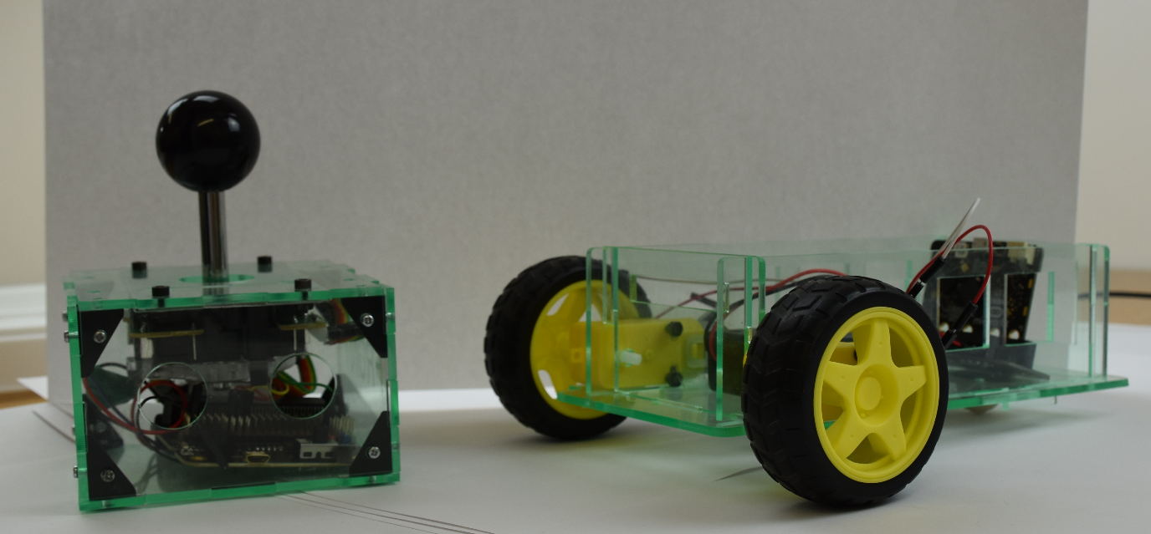
STEM in a Box

Slide 2
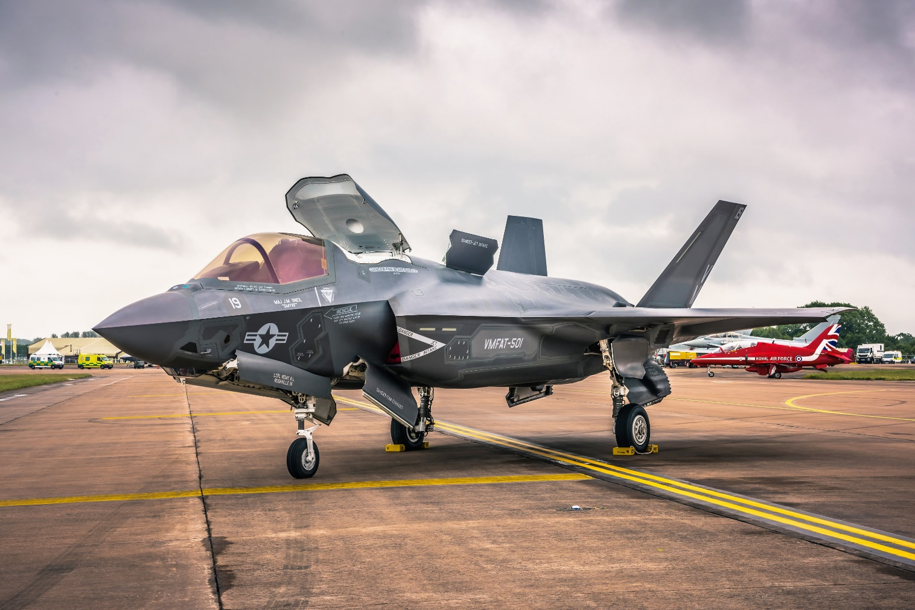
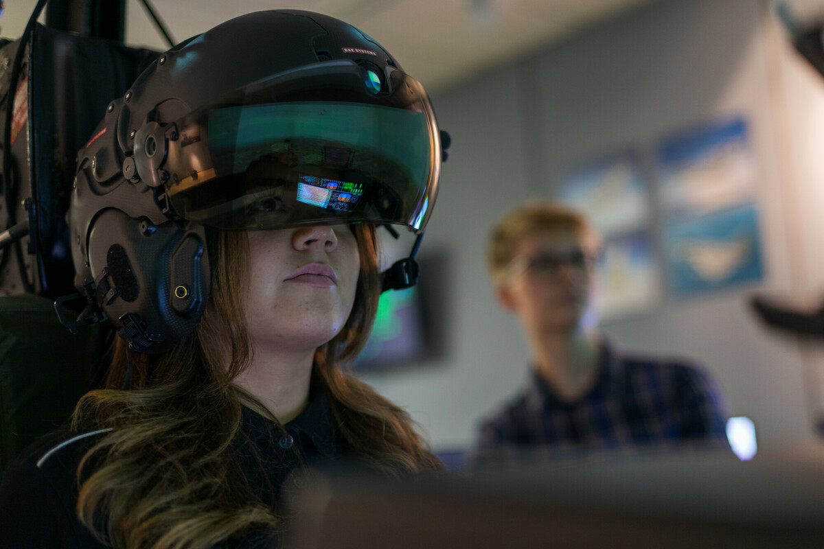
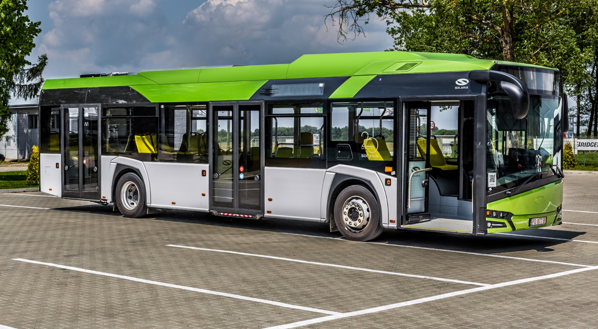
Introduction
We at BAE Systems Rochester we build a large quantity of amazing engineering products which go into many platforms. These include:
Planes
Ships
Submarines
Drones
Bus drive systems
Much, much! more

Slide 3
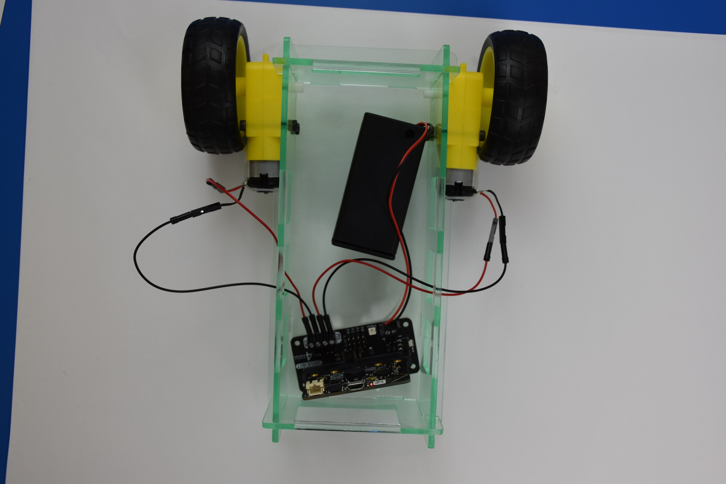
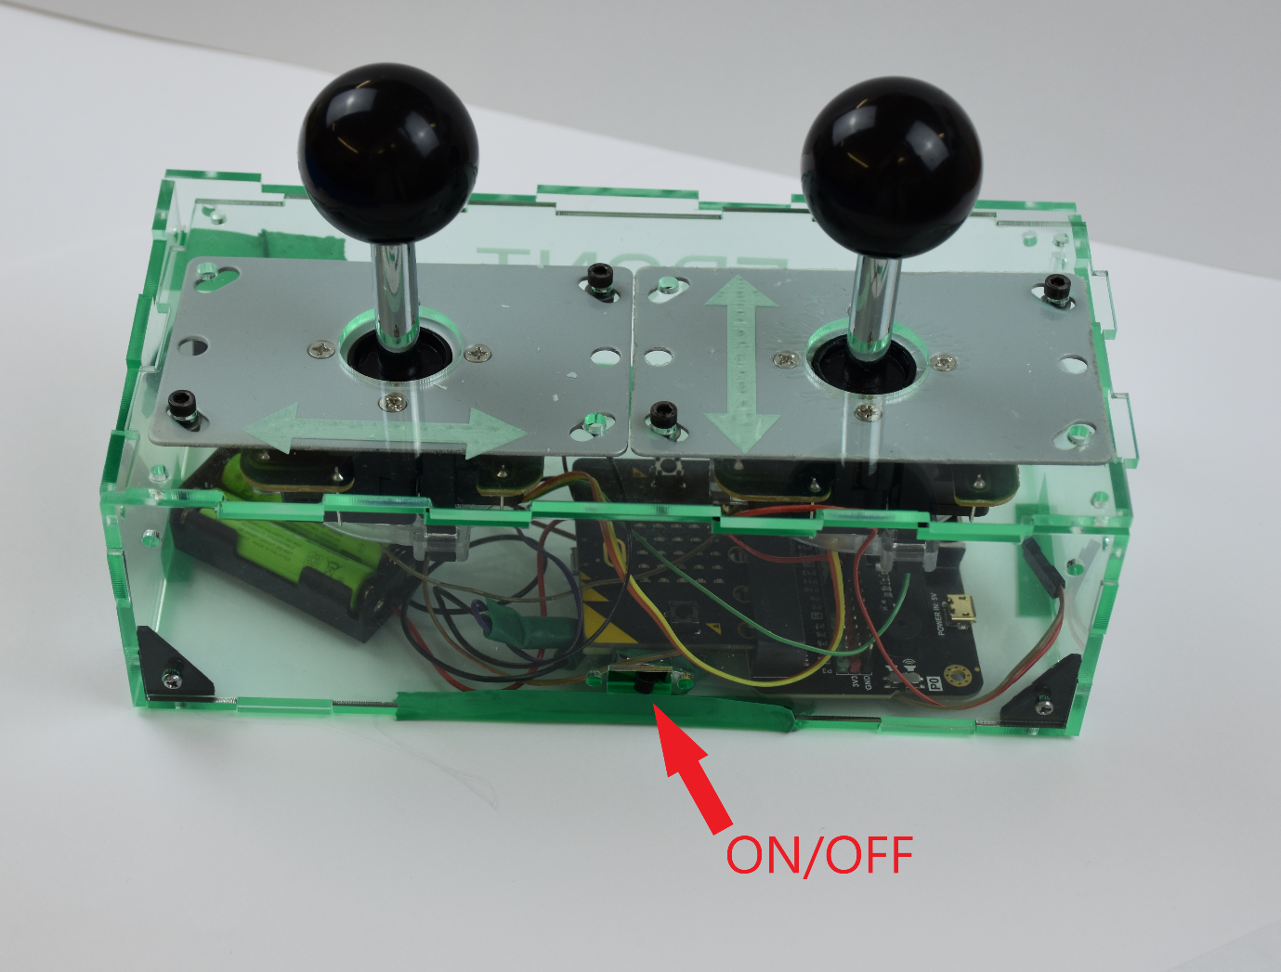
Components
We want you to build a remote control bus which includes:
Electrical components
Building the Bus Chassis and Controller
Programming the Controller and Bus
Operating the Bus as a team around your own obstacle course

Slide 4
Improvements
A lot of engineering isn’t perfect first time around, adding improvements to future iterations is an important aspect of any engineers job.
Can you think of any improvements to the Design of either the Bus, Controller or any thing else within this project?
Don’t limit yourself to the physical components, think about it all.

